Slide 1
Storing Data with Databases Hy-Tech Camp
Notes:
Welcome to the Databases Hy-Tech Camp!

Slide 2
Instructor Introductions
Notes:
Make sure all the instructors introduce themselves

Slide 3
AGENDA
Icebreaker
Presentation
Interactive Activity
Follow-Along Activity
Self-Paced Work
Gimkit
Notes:
Here’s what we will cover in this camp.

Slide 4
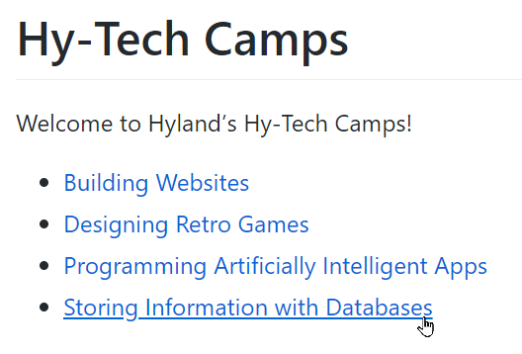
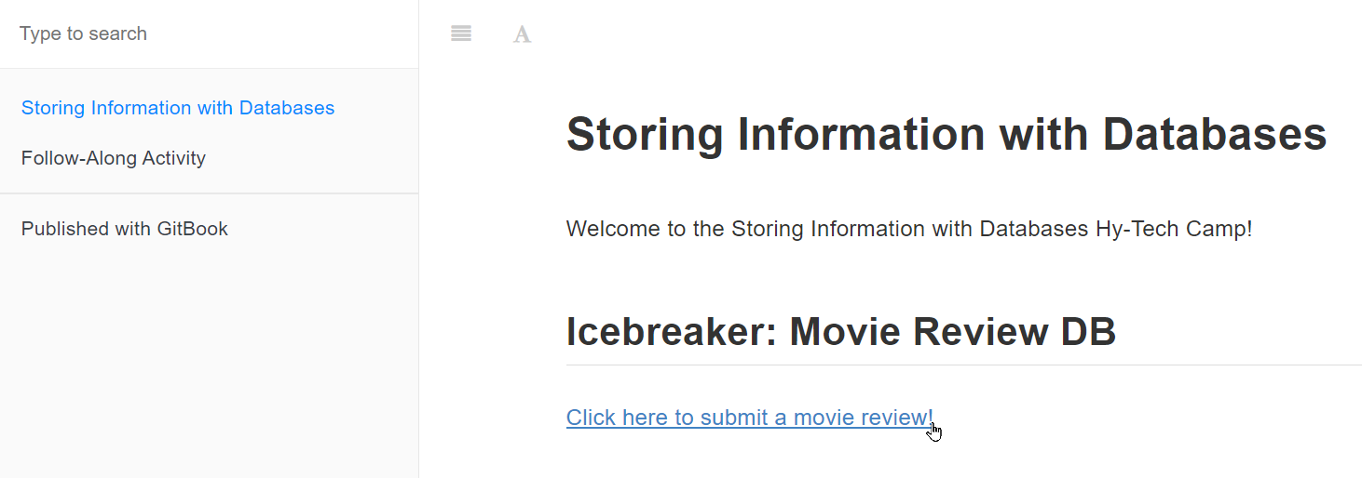
Icebreaker bit.ly/hytechcamps
Notes:
We’re going to start things off with a little icebreaker activity that uses a database! Go to bit.ly/hytechcamps, and find the camp homepage for this camp. Then, click the link under “Icebreaker” and submit a movie review!
After everyone has submitted, we will all introduce ourselves.

Slide 5

Presentation
Notes:
Now it’s time to get into the presentation.

Slide 6
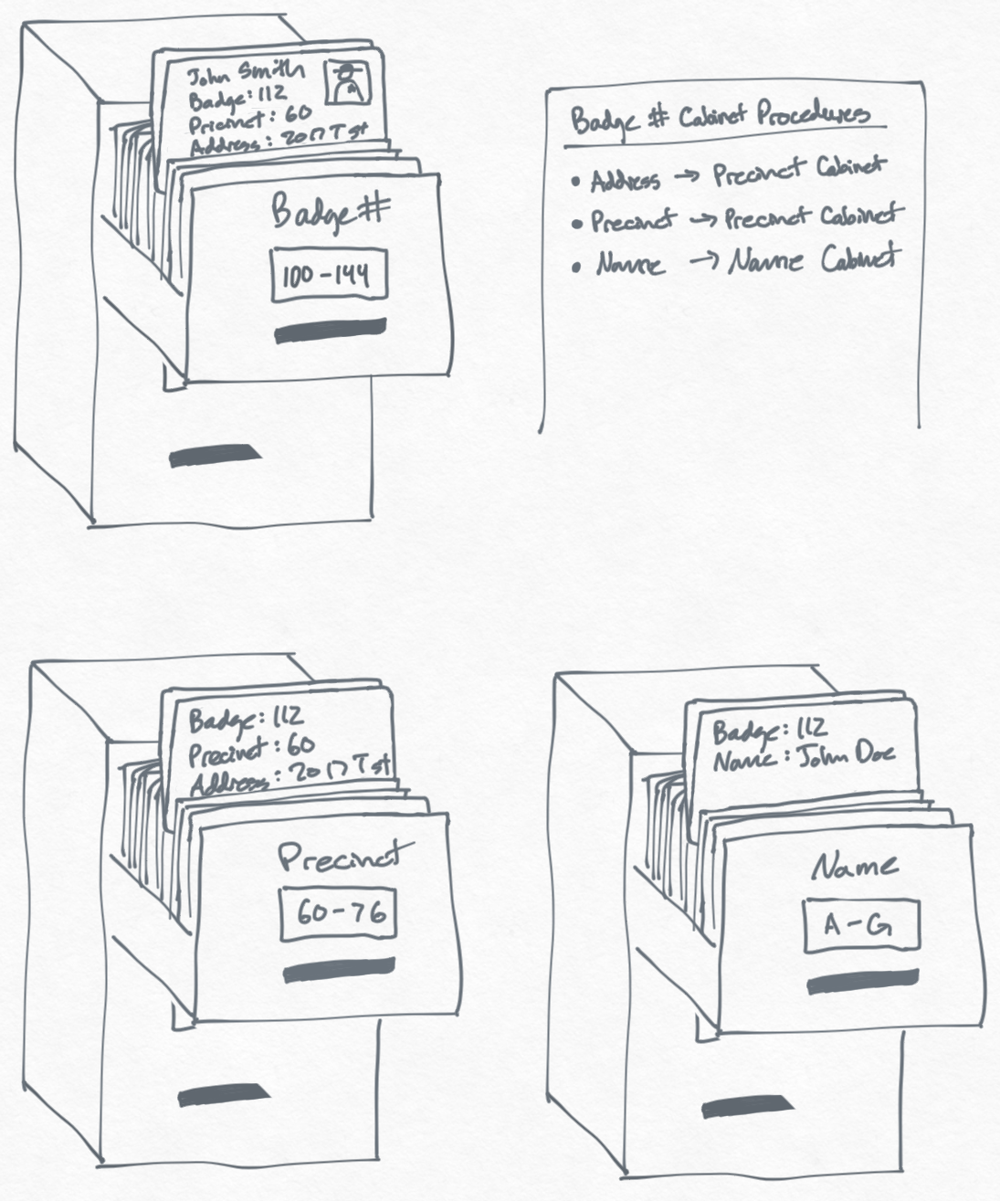
What is a database?
an organized collection of structured information, or data, typically stored electronically in a computer system
Notes:
Does anyone know what a database is?
Here’s a definition from Oracle: an organized collection of structured information, or data, typically stored electronically in a computer system.
Source: https://www.oracle.com/database/what-is-database/

Slide 7
What types of things are stored in databases?
text, numbers, dates, and more!
Facebook posts
Video game catalogs
Concert ticket sales
School records
Movies
(like IMDb)
Sports statistics
Notes:
Anyone have any idea what can be stored in a database?
Data can take many forms, like text, numbers, and dates. That can be used in a variety of fields – theoretically anything can be data.
Whether you know it or not, you have definitely interacted with databases in your daily life. These interactions aren’t usually direct, but behind the scenes, a database powers a lot of digital experiences! These are just a few examples. If you’ve bought a concert ticket, looked at your grades, logged hours on a video game – all of that stuff is stored in a database somewhere. One example is IMDb (which stands for Internet Movie Database). But how is the data actually stored?

Slide 8
Relational Databases
Title | Year | Genre | Director
Billy Madison | 1995 | Comedy | Tamra Davis
The Wedding Singer | 1998 | Comedy | Frank Coraci
Reign Over Me | 2007 | Drama | Mike Binder
Grown Ups 2 | 2013 | Comedy | Dennis Dugan
Uncut Gems | 2019 | Thriller | Josh Safdie & Benny Safdie
Data is stored in tables where each row is a record, and each column is a property
Notes:
Relational databases are one of the main ways to store data.
Relational databases look something like this. What is this? The keyword we’re looking for is “table” – this is a table of Adam Sandler movies! This is how relational databases store data.
Data is stored in tables where each row is a record, and each column is a property. In this case, each row is a movie, and there are four columns with information about that movie. But how do people interact with a relational database?

Slide 9
Structured Query Language
Learn more during the interactive activity!
SQL is the language that lets database users interact with relational databases
What can you do with SQL?
Create new tables
Insert data into tables
Search for data with certain criteria
Connect tables to one another
Pretty much anything!
Notes:
Structured Query language, or SQL (sequel or S.Q.L. depending on preference) is the main way database users can interact with these tables.
SQL allows people to do a ton of different stuff – basically anything – with the data in a database.
Note: we will dig deeper into SQL during the interactive activity that’s coming up after the presentation!

Slide 10
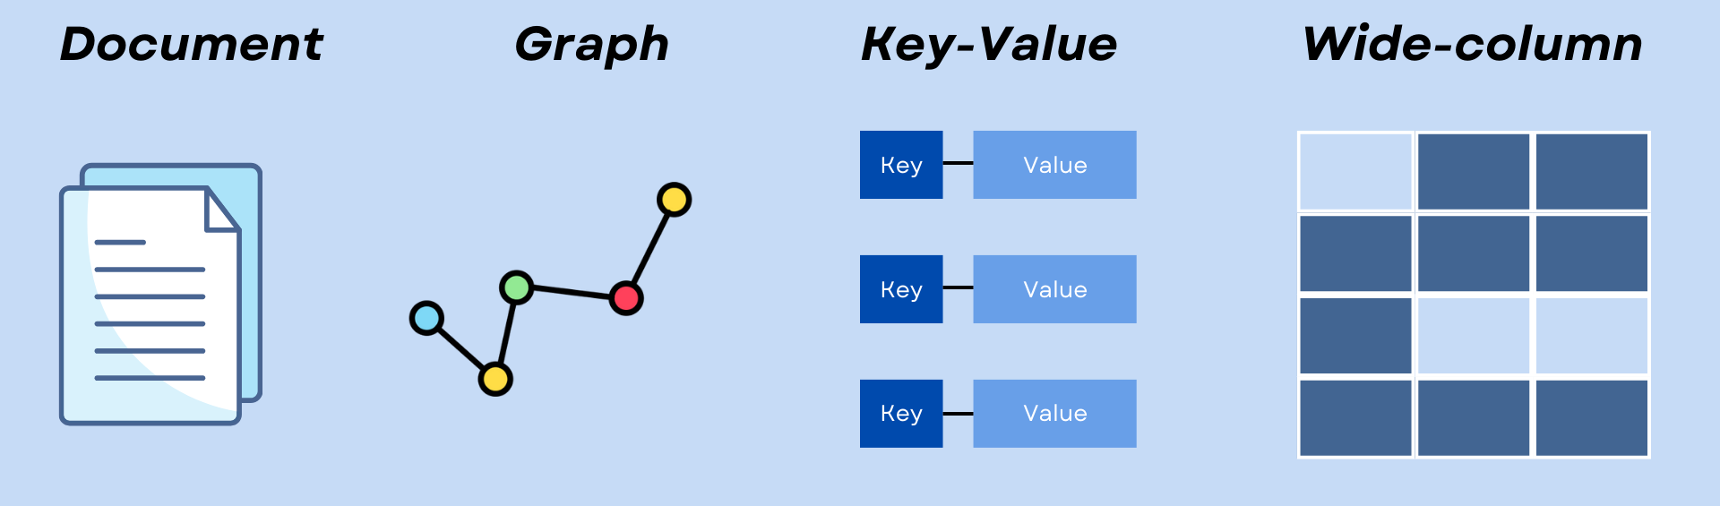
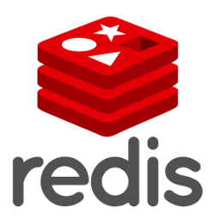

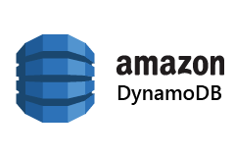

NoSQL
What are NoSQL DBs?
Structure in NoSQL Databases
NoSQL databases (aka "not only SQL") are non-tabular databases and store data differently than relational tables
While SQL databases are strictly structured in tables, NoSQL databases store data in a variety of ways. This allows NoSQL DBs to work well with “unstructured data” – like big data or messy data.
Examples of NoSQL Databases
Notes:
The main other approach to database design is called NoSQL. Any idea what these databases are?
If you said “databases that are not SQL” – you are basically right! NoSQL databases comprise a wide range of approaches – the main thing, though, is that they are NOT relational databases, and do not store data in tables.
Structure in NoSQL databases can be almost anything, including document, graph, key-value, and wide-column databases.
This data is generally less structured than the data in SQL databases. This makes it possible for NoSQL databases to work with data that’s less structured – like big data or messy data.
There are a few different types of NoSQL databases – here are a few. Today, we’ll be using MongoDB!

Slide 11

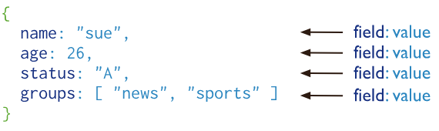
MongoDB is a document database designed for ease of application development and scaling.
A record in MongoDB is a document, which is a data structure composed of field and value pairs:
Notes:
MongoDB is a document database.
Basically, every record (or object) is a document. Each document has fields and values – for example, this document has a “name” of “sue”, an “age” of “26”, etc. What type of record might this be? It looks like it’s a person! MongoDB can store all types of records, and it is extremely flexible.

Slide 12


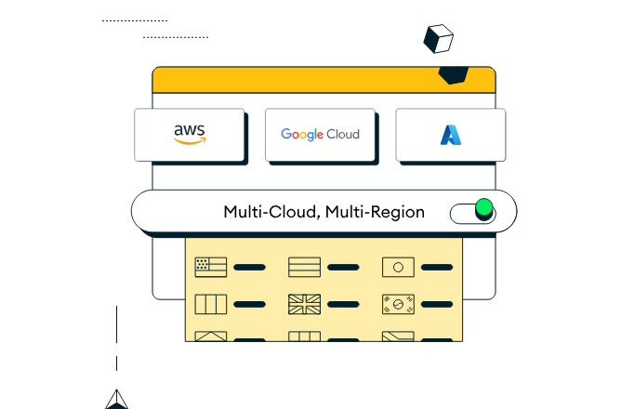
Atlas: Mongodb in the cloud
Learn more during the follow-along activity!
What is the cloud?
What is MongoDB Atlas?
an integrated suite of data services centered around a cloud database designed to accelerate and simplify how you build with data – with a free option!
Reality
A bunch of computers
(i.e., a global network of servers)
Perception
A magic place where everything lives forever
Notes:
One of the nicest things about MongoDB is the ability to store data in the cloud using Atlas. Does anyone know what the cloud is?
You might think it is a magical place where everything is stored (like iCloud photos or Google Drive documents).
Really, it’s just a bunch of computers – the important thing is that they are all connected.
MongoDB Atlas is a platform that allows users to use MongoDB in the cloud – and you can get started for free!
We will be diving much deeper into Atlas during the follow-along activity after the break.

Slide 13

Basic Database Operations: C.R.U.D.
Notes:
Now it’s time to get a little more specific. Anyone know the movie C.H.U.D.? Probably not. Why is that up here? Well, it’s very close to another acronym.

Slide 14

Basic Database Operations: C.R.U.D.
regardless of the approach, these operations are a fundamental aspect of almost any DB
Read
view existing records in the database
Delete
remove existing records from the database
Create
add new records to the database
many applications are built upon the foundation of these four operations!
Update
edit existing records in the database
Notes:
There is a set of basic operations that are quite important for almost any type of database: C.R.U.D.
These operations are fundamental to both SQL and NoSQL databases. So, what are they?
C stands for Create – adding data to the database.
R stands for Read – looking at data that’s already in the database.
U stands for update – taking existing data, and modifying it.
D stands for delete - getting rid of existing data.
You can do quite a bit with just these four operations – in fact, many applications are built entirely with these! Can anyone think of a time they’ve completed any of these actions in a software application?
One of the prime use cases for CRUD operations is social media. Any time you post something, or look at posts, or edit a post, or delete a post – you are performing a CRUD operation!

Slide 15
Interactive Activity SQLBolt
Notes:
Now let’s get into how to actually do these things with real databases! This interactive activity explores SQL more in-depth. Go to bit.ly/hytechcamps and find the link, or just go to SQLBolt.com to get started! See how far you can get with the tutorial.

Slide 16
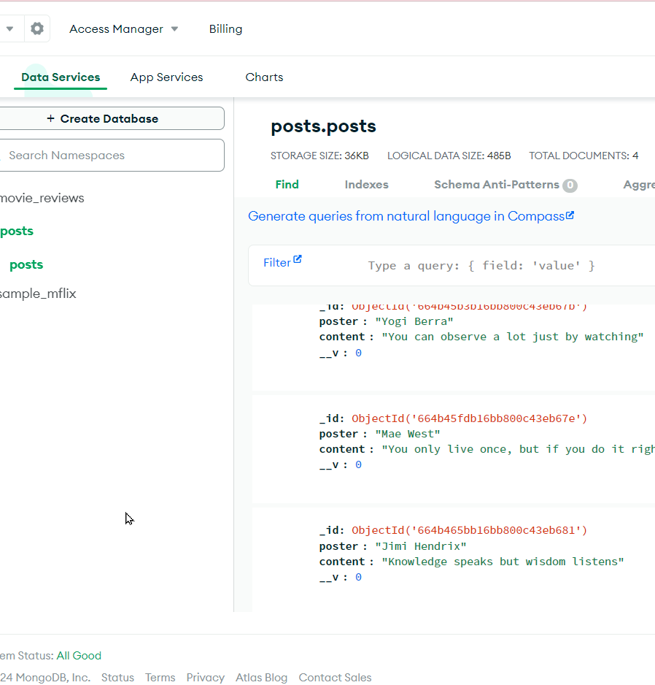
Follow-along activity bit.ly/hytechcamps
Notes:
Now it’s time for the follow-along activity! Head to bit.ly/hytechcamps and find the link on the camp homepage to get started. We will be building out our own MongoDB database using Atlas – and connecting to it with a web application!

Slide 17
GIMKIT
Notes:
I hope you were all paying attention – we’re going to test you by playing Gimkit! Go to gimkit.com/join, and we will host the quiz game.

Slide 18
THANK YOU
techoutreach@hyland.com
Notes:
Thank you so much, we hope you enjoyed this camp!

